Slide 1
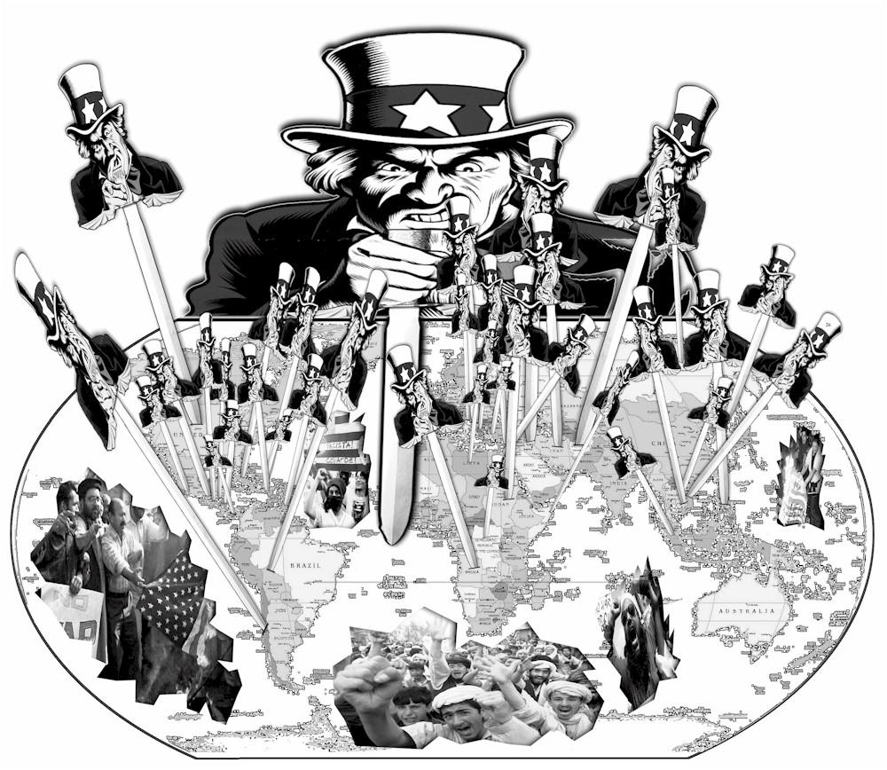

Slide 2
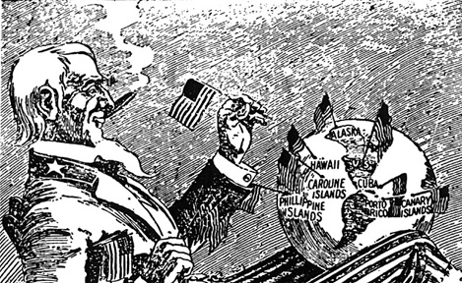

Slide 3
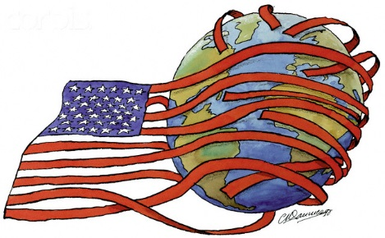
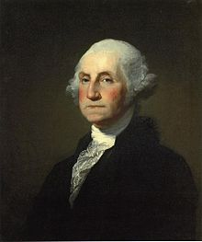
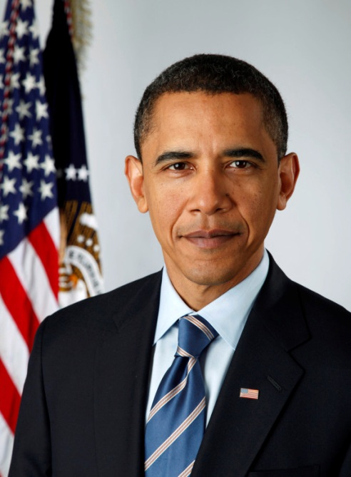
The Dark Side of American History, 1783-2014: Two Centuries of the Foreign Policy of the U.S. Government in Two Hours
Notes:
This doesn’t have to be a negative image! Those stripes could be good, perhaps?

Slide 4
What?

Slide 5
Why?
Who?

Slide 6
"American history is longer, larger, more various, more beautiful, and more terrible than anything anyone has ever said about it.”-James Baldwin. This class will focus on the "terrible" parts of American history. We will briefly review several controversial events and actions of the American government on US soil, from slavery to civil liberties in the age of the War on Terror, and will then discuss and debate with each other several questions relating to these topics. Some think that though our government has done wrong things in the past, we no longer engage such cruel behavior. Others think that America's past is innocent and wonderful, but that today, our policies are more cruel than they have been in the past. Can we still call ourselves the "land of the free and home of the brave?" What can we do to make up for America's past cruelties? And most importantly, how do we bring an end to those being committed right now? Warning: some disturbing photographs of war and violence will be seen.

Slide 7
Me: a disclaimer
-It’s the mileage, not the years! (same goes for older students in class)
-Bias, opinions, and facts
-I’m not God ☹
Notes:
Sources, citation. Leave at any time you want to. This is the prototype class. You guys are the pioneers.

Slide 8
When?

Slide 9
Where?

Slide 10
How?

Slide 11
-The “light side”
-Not all other countries are perfect either
-Let’s go snorkeling…
-…then scuba diving! -Change our world?

Slide 12
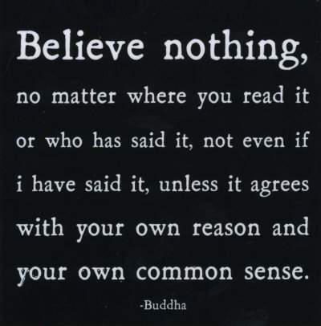

Slide 13
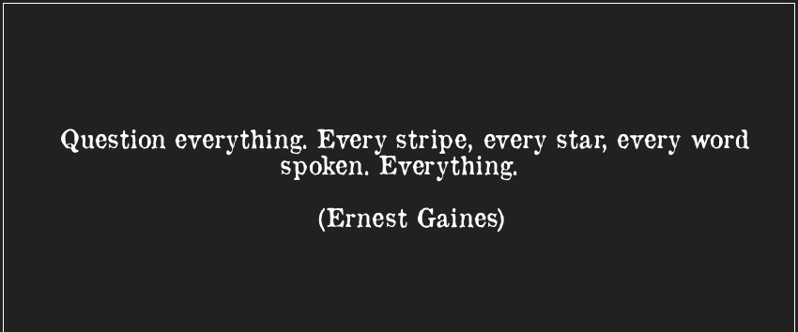

Slide 14
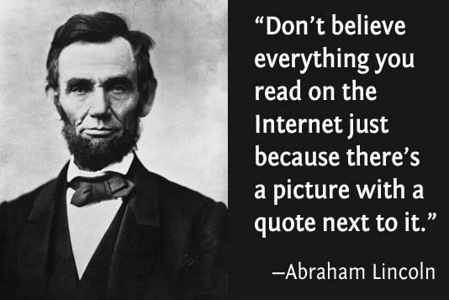

Slide 15
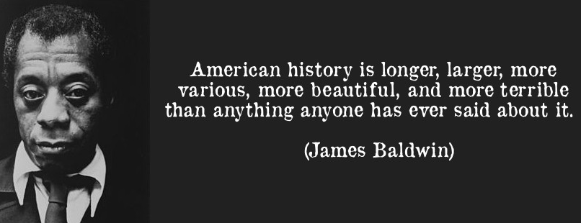
Notes:
Obviously, we’ll be focusing on the terrible. Also, does most of the beauty arise from vanquishing the terrible? Yet we will be hopeful at the end, and discuss what we can do to make up for an stop the terrible and replace it with beautiful. (writing new pledges)

Slide 16
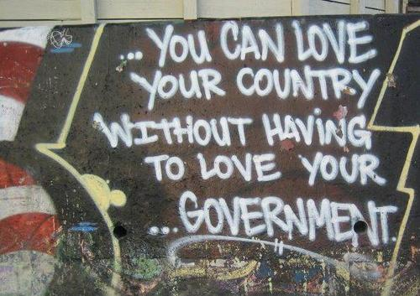

Slide 17
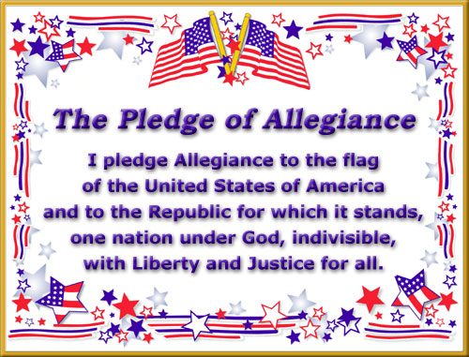

Slide 18
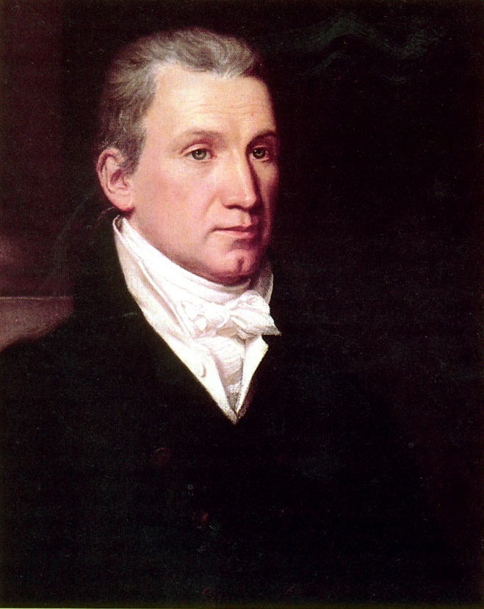
Monroe Doctrine: 1823
European powers: do not interfere in the affairs of the Western Hemisphere
Latin American revolutions

Slide 19
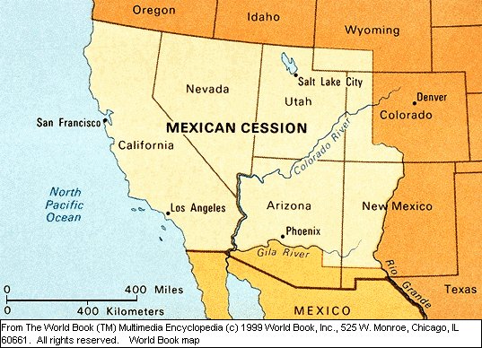
Mexican-American War: 1846-1848

Slide 20
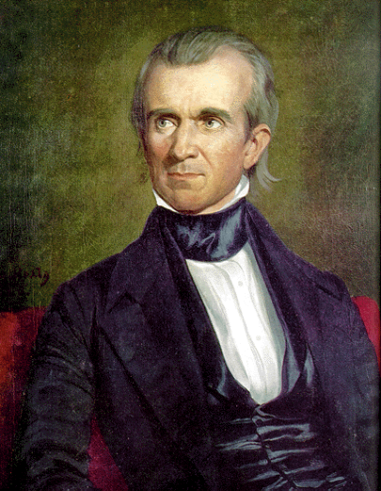
Tensions over the US annexing the independent Republic of Texas in 1845.
President James Polk also had expansionist goals to further the fulfillment of Manifest Destiny; he and other Democrats also wanted to gain more land to expand slavery.
13,000 Americans killed, 16,000 Mexicans killed.

Slide 21
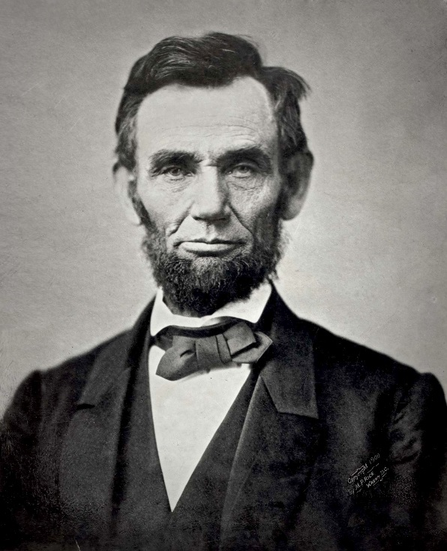
Spot Resolutions and Justification of the War
Democrats: war was defensive against Mexico
Whigs & Abe Lincoln: unnecessary invasion into Mexican territory
Mexican Cession, payment

Slide 22
Beyond California
1860’s—Alaska
Besides Manifest Destiny, there was also what came to be known as “Yankee imperialism.” After California, there clearly was no more “West” frontier to expand into, and so the Hawaiian islands came next.

Slide 23
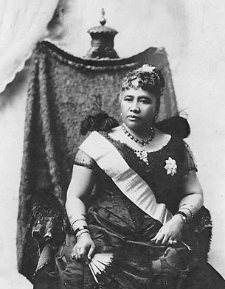
Hawaii, 1893
In 1891, Queen Liliuokalani had implemented a new constitution to give herself more power and be less a subject of American sugar planters, who were backed up by the new Pearl Harbor military base.

Slide 24
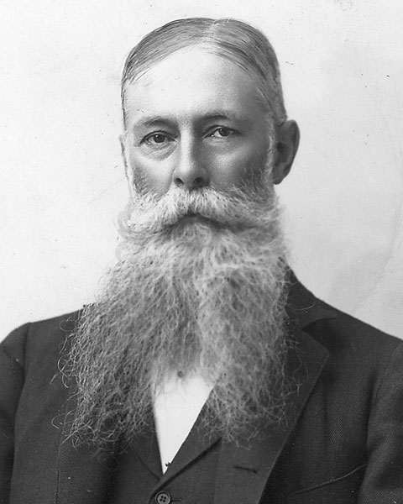
-Early 1893: Sanford Dole
-300 marines
US minister John Stevens
Stevens officially recognized Dole’s new provisional government.
President Cleveland tried to restore Liliuokalani, but Dole refused

Slide 25
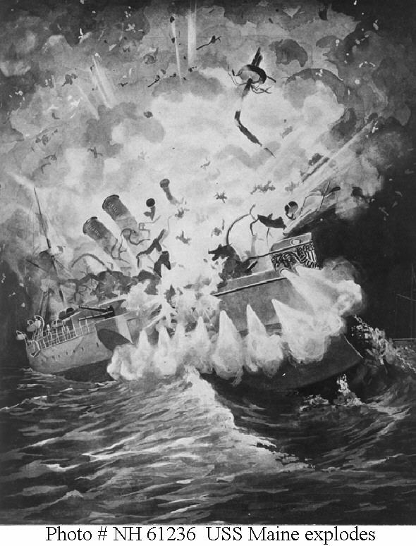
A “Splendid Little War”
1898—the USS Maine explodes in Havana Harbor, Cuba. Cause still unknown.
“Remember the Maine! To Hell with Spain!”
Resulted in limited US control over Cuba, and full control over Puerto Rico, Guam, and the Philippines.

Slide 26
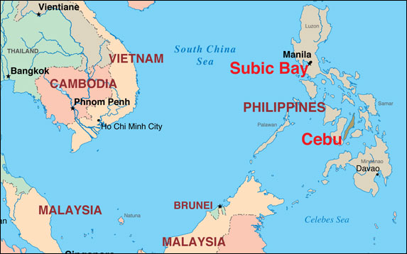
Philippine-American War
Emilio Aguinaldo of the Philippines tried to establish an independent Philippines in 1899, but the US refused to recognize it. The US and Philippines went to war, resulting in a US victory in 1902. The Philippines weren’t granted independence until 1946.

Slide 27
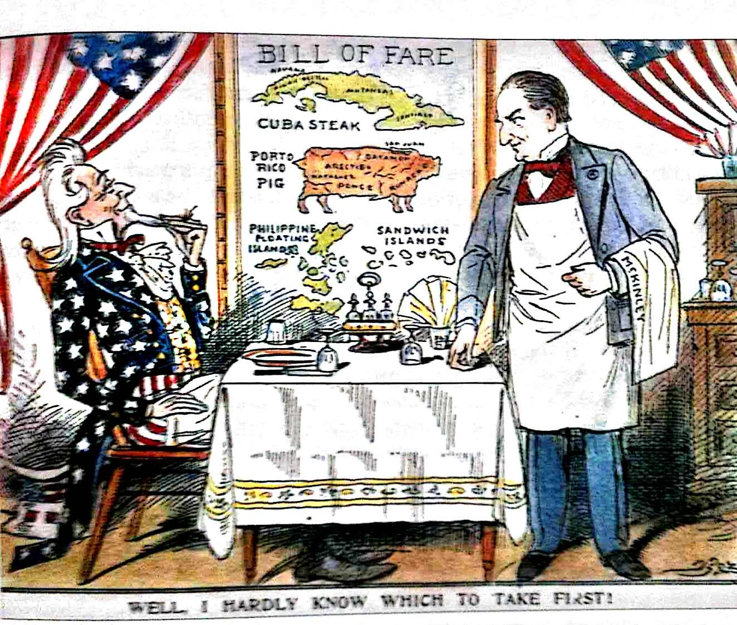

Slide 29
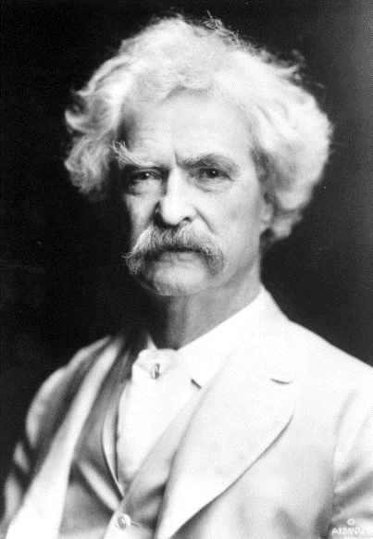
“I have seen that we do not intend to free, but to subjugate the people of the Philippines. We have gone there to conquer, not to redeem. It should, it seems to me, be our pleasure and duty to make those people free, and let them deal with their own domestic questions in their own way. And so I am an anti-imperialist. I am opposed to having the eagle put its talons on any other land.”—Mark Twain, member of the Anti-Imperialist League

Slide 30
World War II
Dresden Bombing—both sides bombed civilian targets in cities, but the Allied bombing of the German city of Dresden was one of the worst.
30,000-130,000 German civilians killed in February 1945.
Why was Dresden bombed when it did appear that the war would be ended in the near future?

Slide 31
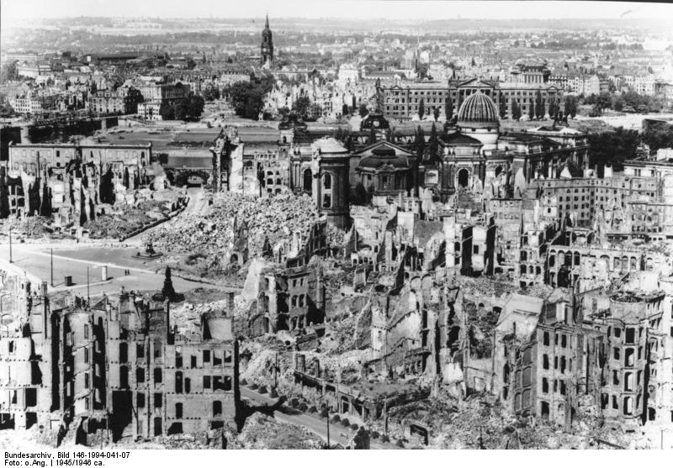

Slide 32
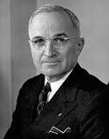
World War II
Japan Atom Bombs—in August 1945 the Germans had been beaten, but the militant Japanese soldiers saw it as a disgrace to surrender, and would fight to the end even though cities were being firebombed by the Allies.
Two atom bombs had to be dropped, killing 150,000-250,000 on impact and thousands more from fallout, before the Japanese capitulated.
It was calculated that perhaps a million American and Japanese lives would be lost taking Japan conventionally.
What would you do in Truman’s position?
Notes:
Truman wanted just small towns bombed.

Slide 33
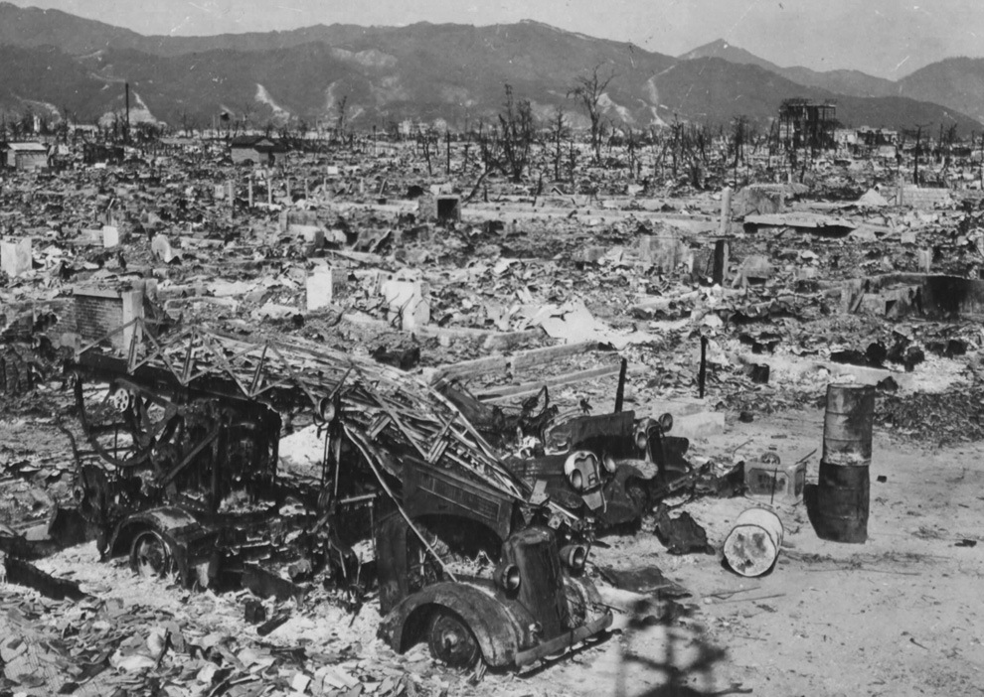

Slide 34
Cold War Policy
Following the eradication of the fascist threat of Nazi Germany in 1945, the democratic-capitalist world turned its attention to the monolithic entity of communism. An “iron curtain” fell over Europe as Western Europe was influenced by the capitalist US, and Eastern Europe was influenced by the communist USSR. Other nation-states on all continents were coaxed into this paradigm as well, though some resisted being drawn into either camp.

Slide 35
Containment
From 1948 to 1991 (the fall of the USSR), the US tried many different but similar approaches to combating the “threatening” spread of communism. The “domino theory” was an unproved fear that if one country went communist in a region, others around it would follow.
Various politicians, starting with Truman and George F. Kennan, started the policy of containment to prevent the domino theory from taking effect.

Slide 36
Presidents Truman, Eisenhower, Kennedy, Johnson, Nixon, Ford, Carter, Reagan, and Bush all practiced various forms of containment, often to the detriment of foreign populations.
Containment not only consisted of economic support to capitalist countries and politicians, but also political and military force when necessary. The US involved itself in the affairs of Cuba, Haiti, Mexico, El Salvador, Nicaragua, Egypt, Israel, Iran, Taiwan, South Korea, Greece, Turkey, Brazil, Argentina, Somalia, the Congo, and others. Many times (not always) these interventions consisted of supporting violent anti-communist and often fascist regimes; as long as they weren’t communist and were capitalist trading partners, they were fine in containment’s eyes.
Notes:
Capitalism (I think) isn’t intrinsicalyl bad, it’s just that here it trumped the human rights of people under fascist regimes.

Slide 37
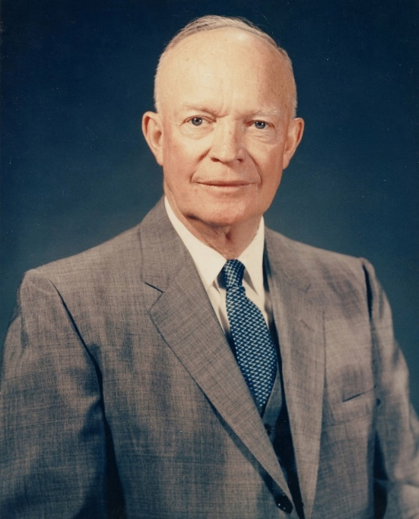
Eisenhower: Containment on the Cheap
Iran, 1953
Guatemala, 1954

Slide 38
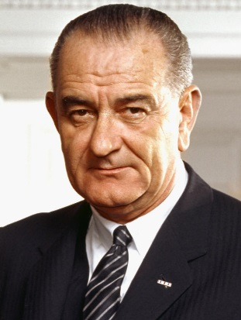
Domino Theory?
In reply to a formal question submitted by President Lyndon B. Johnson–”Would the rest of Southeast Asia necessarily fall if Laos and South Vietnam came under North Vietnamese control?”–the Central Intelligence Agency (CIA) submits a memo that effectively challenges the “domino theory” backbone of the Johnson administration policies. This theory contended that if South Vietnam fell to the communists, the rest of Southeast Asia would also fall “like dominoes,” and the theory had been used to justify much of the Vietnam War effort.

Slide 39
CIA: “Furthermore,” the report said, “a continuation of the spread of communism in the area would not be inexorable, and any spread which did occur would take time–time in which the total situation might change in any number of ways unfavorable to the communist cause.” The CIA report concluded that if South Vietnam and Laos also fell, it “would be profoundly damaging to the U.S. position in the Far East,” but Pacific bases and allies such as the Philippines and Japan would still wield enough power to deter China and North Vietnam from any further aggression or expansion.

Slide 40
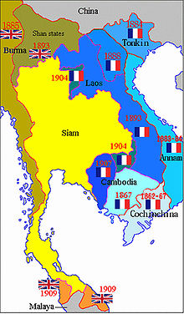
French Indochina
From 1950 to 1954, France tried to recolonize Indochina, namely Vietnam.
Although it was clear that the Vietnamese did not want French rule, there were many socialist and communist activists in France, and the US feared that if France lost Vietnam, it would go communist. So the US supported the French military in trying to colonize Vietnam.
When the French finally lost in 1954, the US was ready to pit capitalist South Vietnam against communist North Vietnam.

Slide 41
The Vietnam War
Under Eisenhower in the ‘50s, the US (often through the CIA) consistently forced Ngo Diem upon the South Vietnamese, rigging the elections so that he won by more than 100% in some cities.
Kennedy may have been ready to start deescalating in the early ‘60s, but when Johnson took office, he went ahead with the war to stop the communist North Vietnamese from taking over the south.

Slide 42
Unpopularity Across the Globe
The Vietnamese already didn’t like the Americans for supporting Diem. The military means used to attain the ends of containment were catastrophic. Biological weapons such as Agent Orange destroyed forests and dwellings, and physically maimed and killed civilians in both North and South Vietnam as US soldiers tried to kill as many communist guerrillas (Vietcong) as possible. The more the military tried, the more demonized they became, especially with Wounded Knee-like atrocities by soldiers like the My Lai Massacre.
The war is infamously unpopular to many Americans, since 50,000 American soldiers died, and six times as many were wounded, apart from the half million Vietnamese civilians killed.
Notes:
My Lai-300-400 dead.

Slide 43
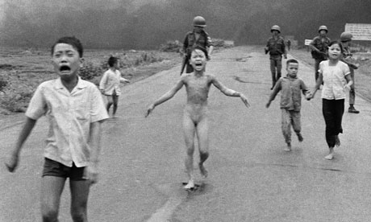

Slide 44
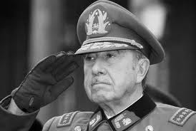
Chile, 1973
Yet one year after the optimistic Communique, the CIA supported Chilean General Pinochet in a military coup against Marxist leader Allende, who was killed in the process. The US continued to support Pinochet’s oppressive regime until 1990.
Allende had tried to nationalize American copper mines, but why did America control another country’s copper mines in the first place?

Slide 45
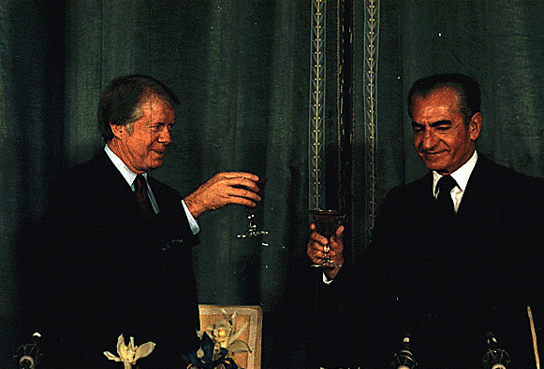

Slide 46
Pol Pot: Revenge on Vietnam

Slide 47
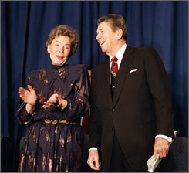
Reagan and Kirkpatrick
Kirkpatrick: Dictatorships and Double Standards
Authoritarian=☺
Totalitarian=☹

Slide 48
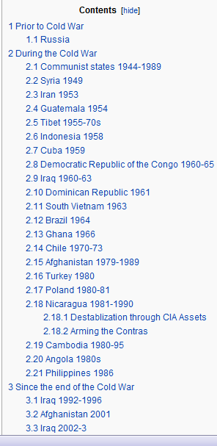
Wikipedia Covert United States foreign regime change actions. Cruel movements or regimes
-Iran
-Guatemala
-Indonesia
-Cuba
-Congo
-South Vietnam
-Chile
-Nicaragua
-El Salvador
-Cambodia
-Angola
Notes:
Should we be policing the world?

Slide 49
Modern Controversies: The Global War on Terror

Slide 50
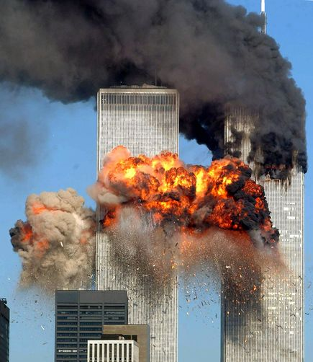
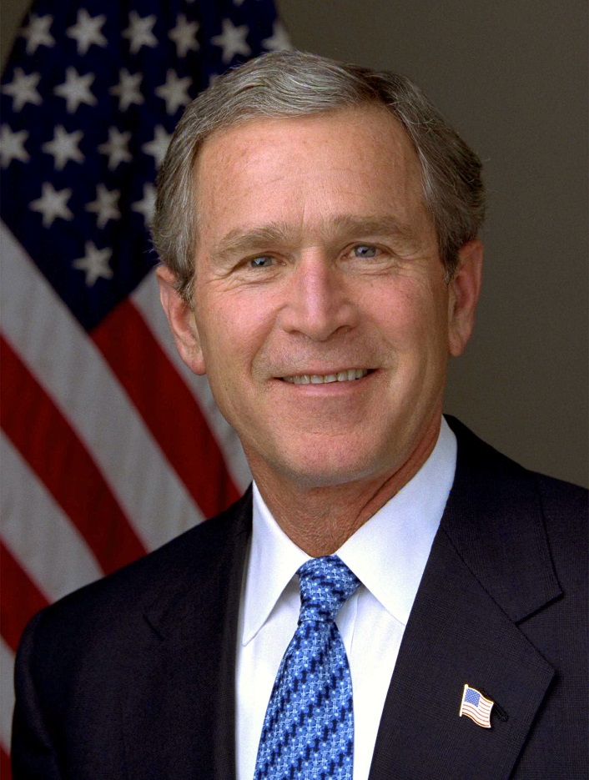
Afghanistan—Defensive?

Slide 51
Robert Bales—The Afghani My Lai
http://www.youtube.com/watch?v=yAV2MpBy22s

Slide 52
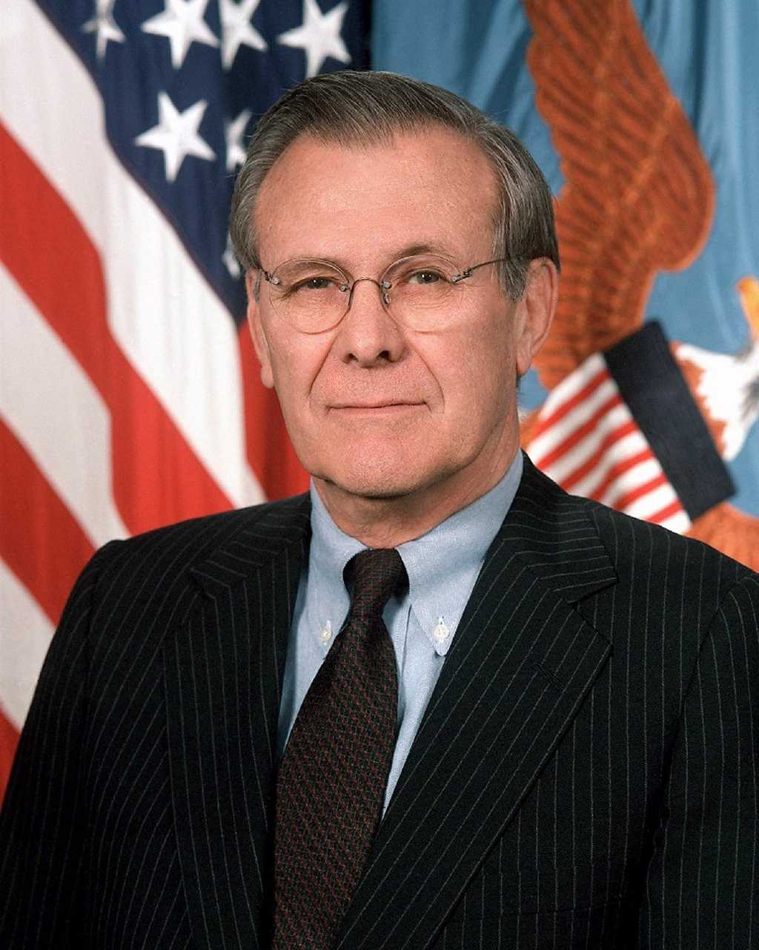
Iraq—Defensive?
Qaeda-nuke nexus
The absence of evidence
Donald Rumsfeld and his
“known unknowns”

Slide 53
“enhanced interrogation”

Slide 54
Drones
http://drones.pitchinteractive.com/

Slide 56
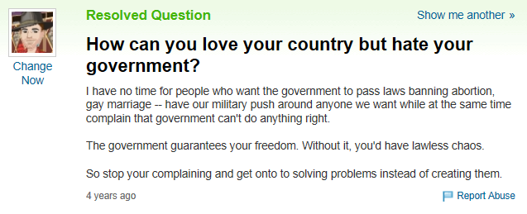
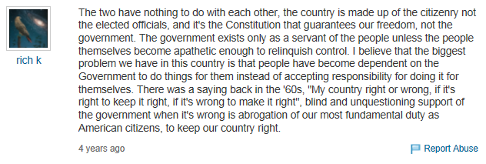
Notes:
Anonymous internet people often have insightful things to say!

Slide 58
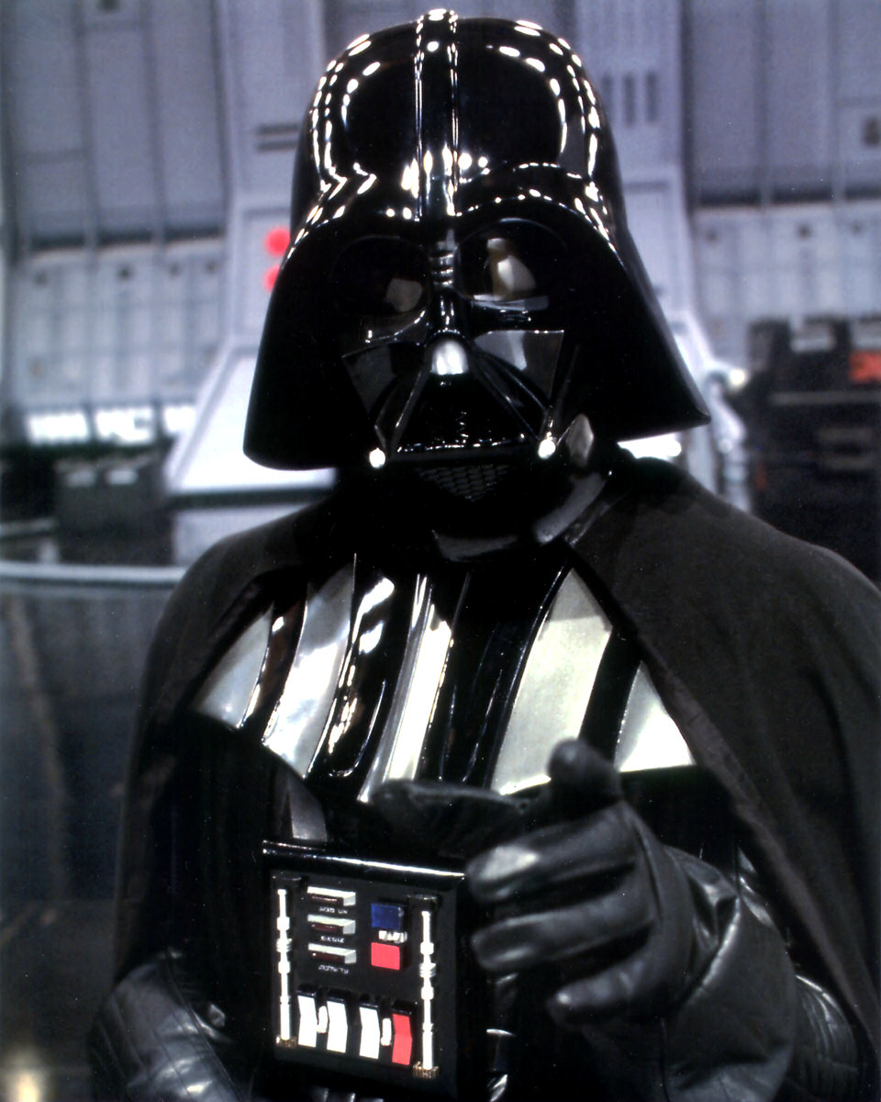

Slide 59
